Slide 1
Agentic Smart Contracts
Agentic AI, Fintech, & Data Economy
Fall 2025
December 1, 2025
Turning contracts into living, self-auditing, digital systems
Chaitya Shah, Nami Jain, Yegan Dhaivakumar, Chunghyun Han

Slide 2
Why Smart Contracts still feel manual?
Smart contract creation today is fragmented, requiring separate tools for writing, validating, and deploying, slowing development and increasing the risk of costly vulnerabilities

Slide 3
A self-improving Smart Contract Ecosystem
1

Slide 4


Agentic Smart
Contracts
Agentic AI, Fintech, & Data Economy
December 1, 2025
Turn plain English into ready-to-deploy smart contracts in minutes
No more juggling tools
Catches risks before they become expensive bugs

Slide 5

Our Methodology
Agentic AI, FIntech, & Data Economy
December 12, 2025
1
2
3
4
5
Defined the AG Pipeline
Structured the Schema
Connected MCP Tools
Validation + Refinement Loop
Agents + UI
Broke the workflow into three core stages: generation, validation, and refinement
Used Pydantic models (SmartContract, ContractClause) so every tool reads/writes the same structured fields (code, clauses, flags, errors)
Built MCP server with generate_smart_contract (Gemini 2.0 Flash) and generate_smart_contract_pretrained (FSM-tuned TinyLlama) to turn user prompts into Solidity
Used validate_smart_contract to compile and sandbox-deploy, refine_contract to fix code from real error logs, and web_search for extra context when needed.
Wired these tools into a CrewAI agentic pipeline and exposed the full loop (logs, errors, final code, deploy tests) through a Streamlit interface

Slide 6

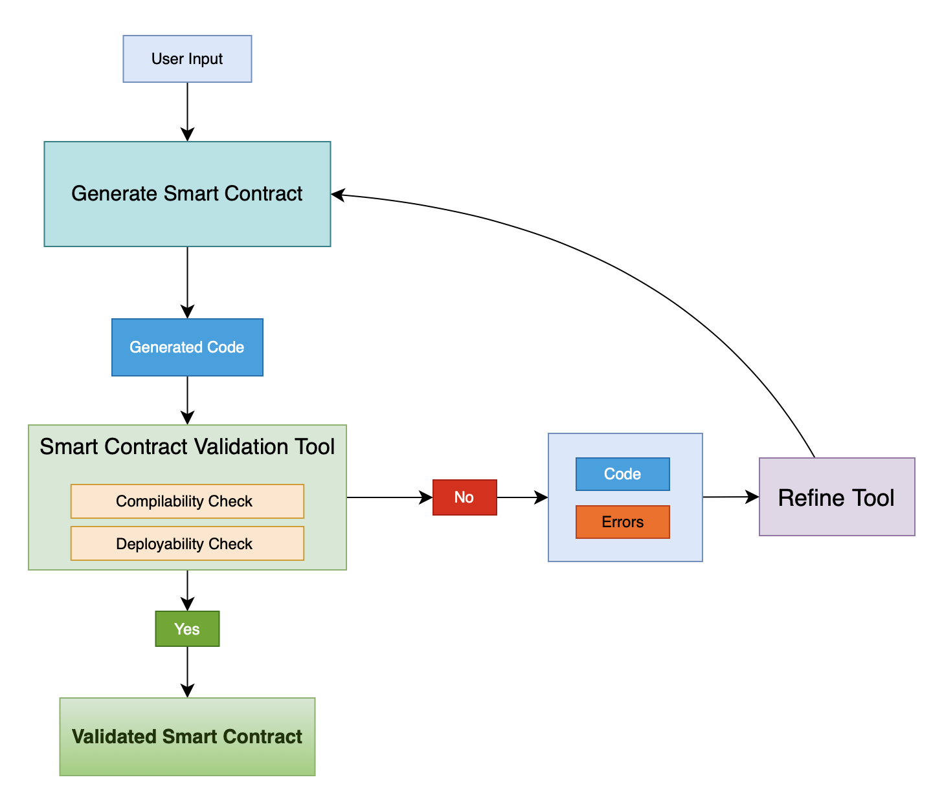




How it Works
Describe the Contract
Provide a natural-language description of the contract’s logic, roles, rules, and any constraints or preferences
Autonomous Pipeline
The agentic loop generates the Solidity code, compiles it, catches errors, and automatically refines the contract until it’s deployable.
Deploy + Review
View the final validated contract, inspect all logs and iterations, and interactively deploy/test it in the sandbox environment.
Agentic AI, Fintech, & Data Economy
December 1, 2025
1
2
3

Slide 7

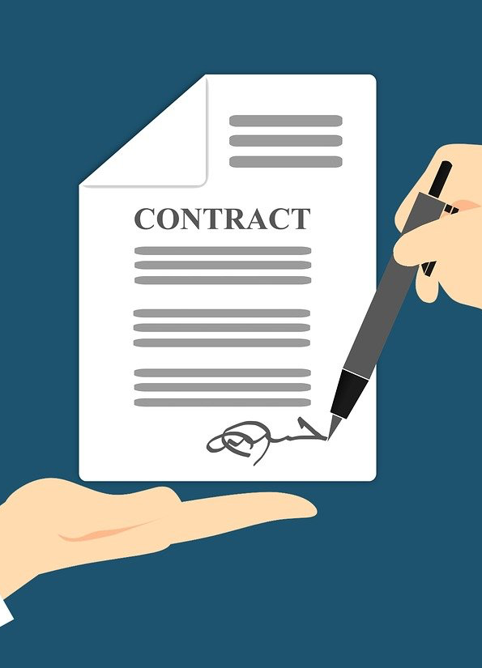
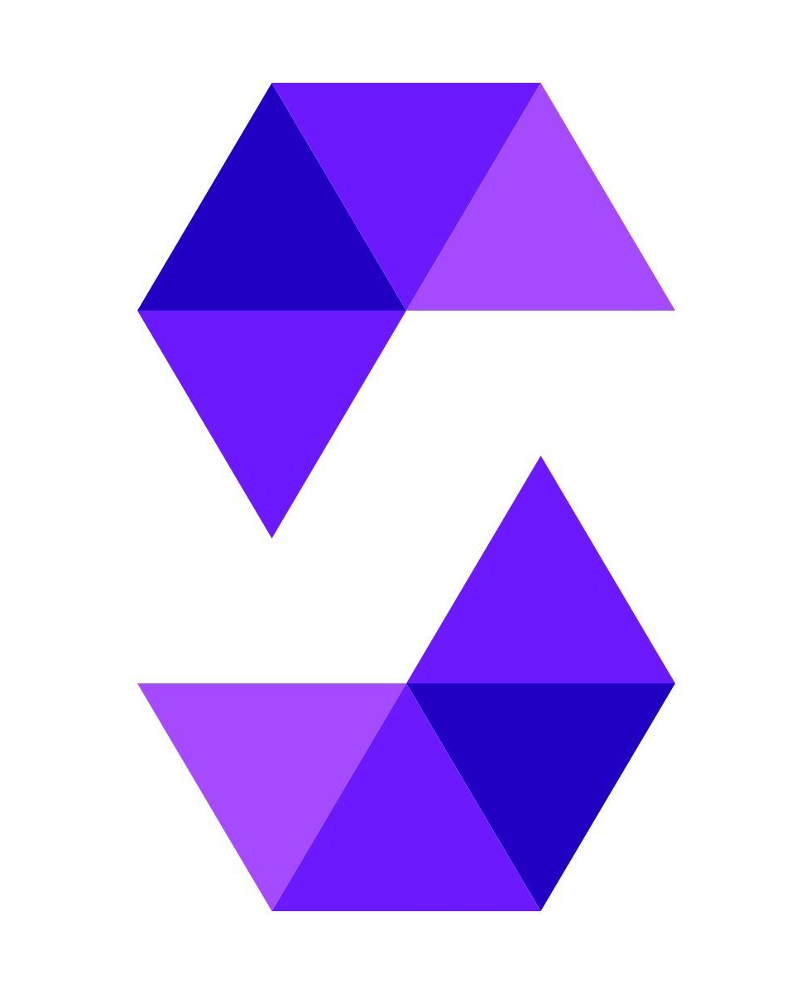
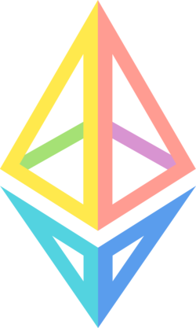
Gemini Example
The system calls the generation tool using the selected LLM, in this case Gemini.
The output includes a complete Solidity contract, along with structured details such as clauses and high-level explanations.
Agentic AI, Fintech, & Data Economy
December 1, 2025
00
Metric description

Slide 8


Slide 9
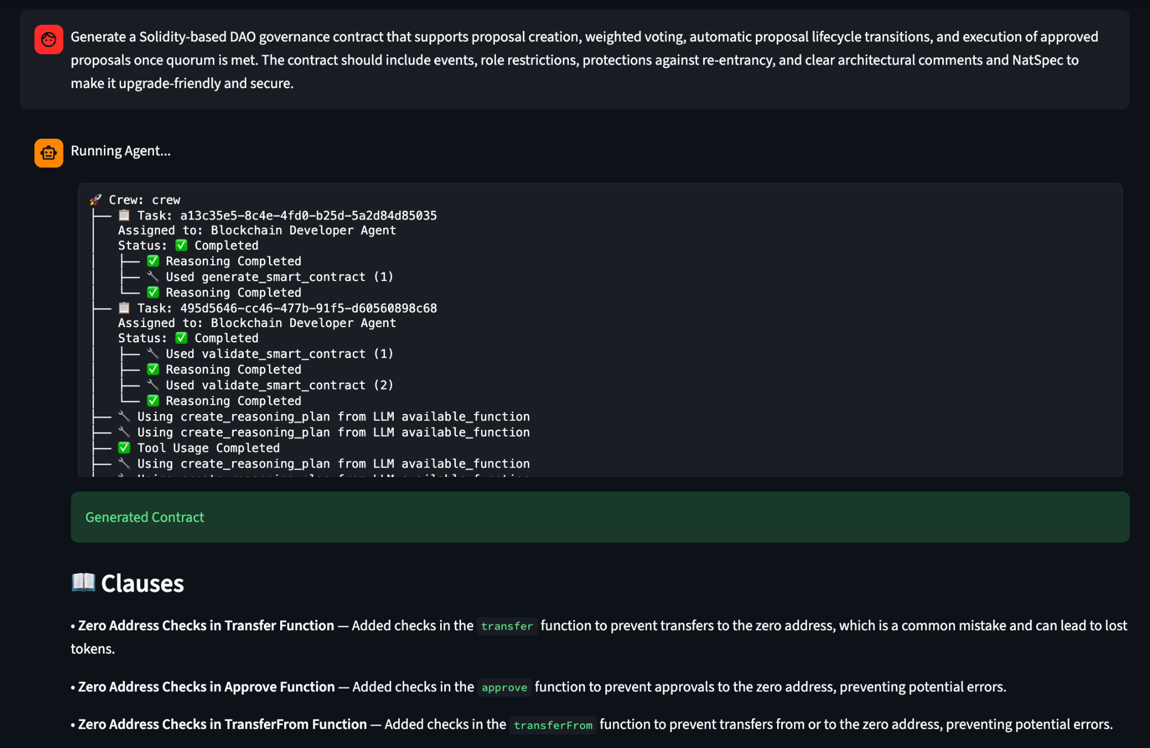

Slide 10
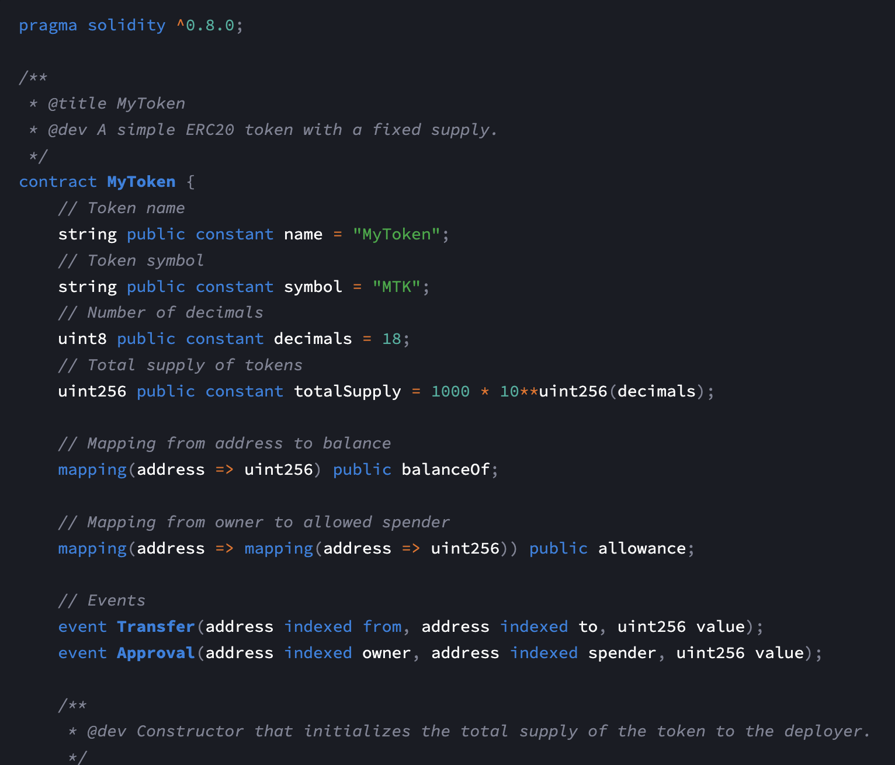

Slide 11
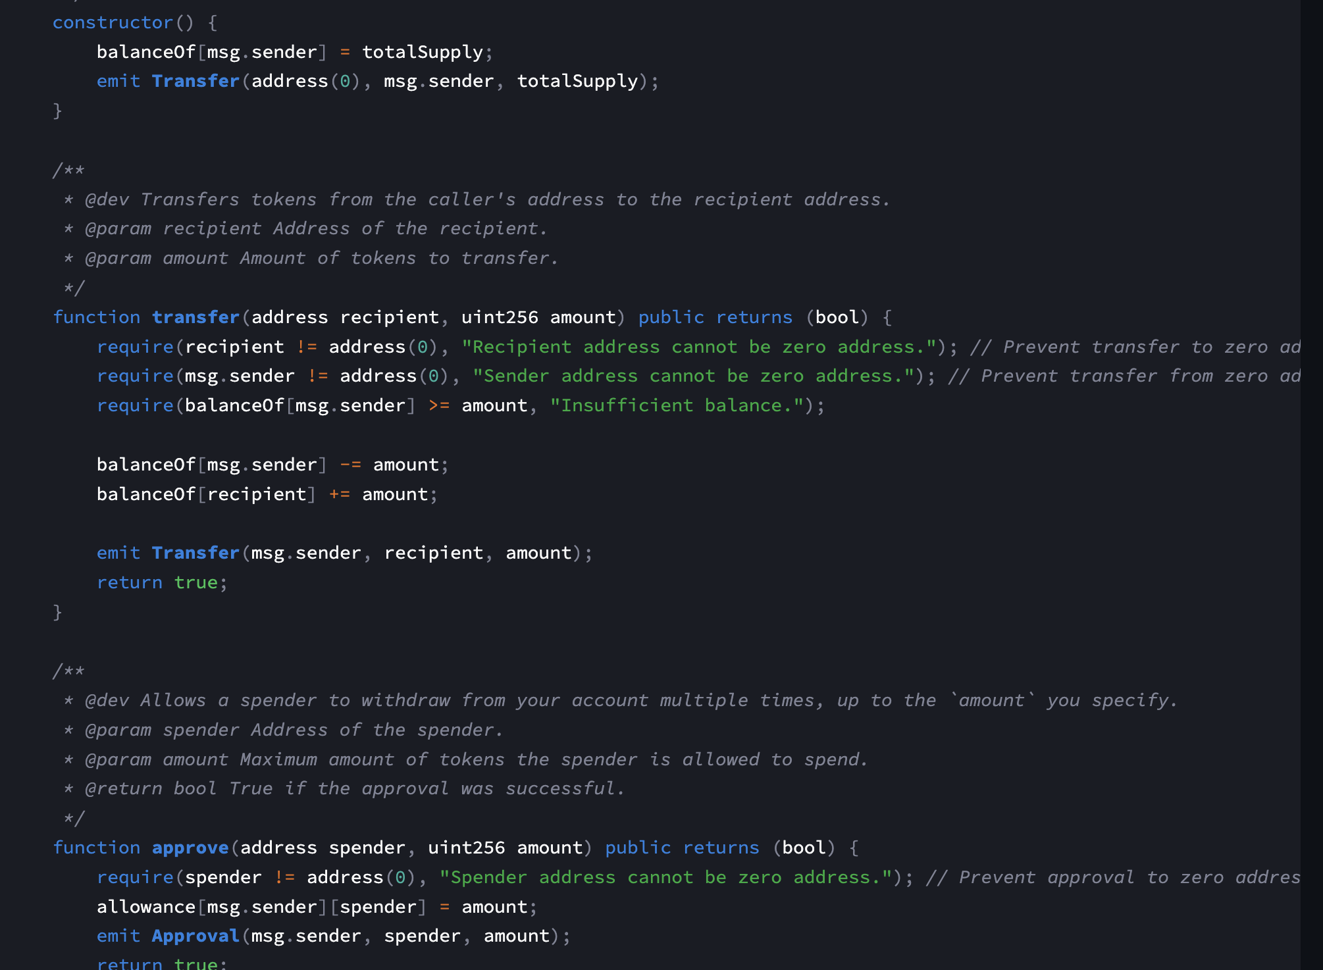
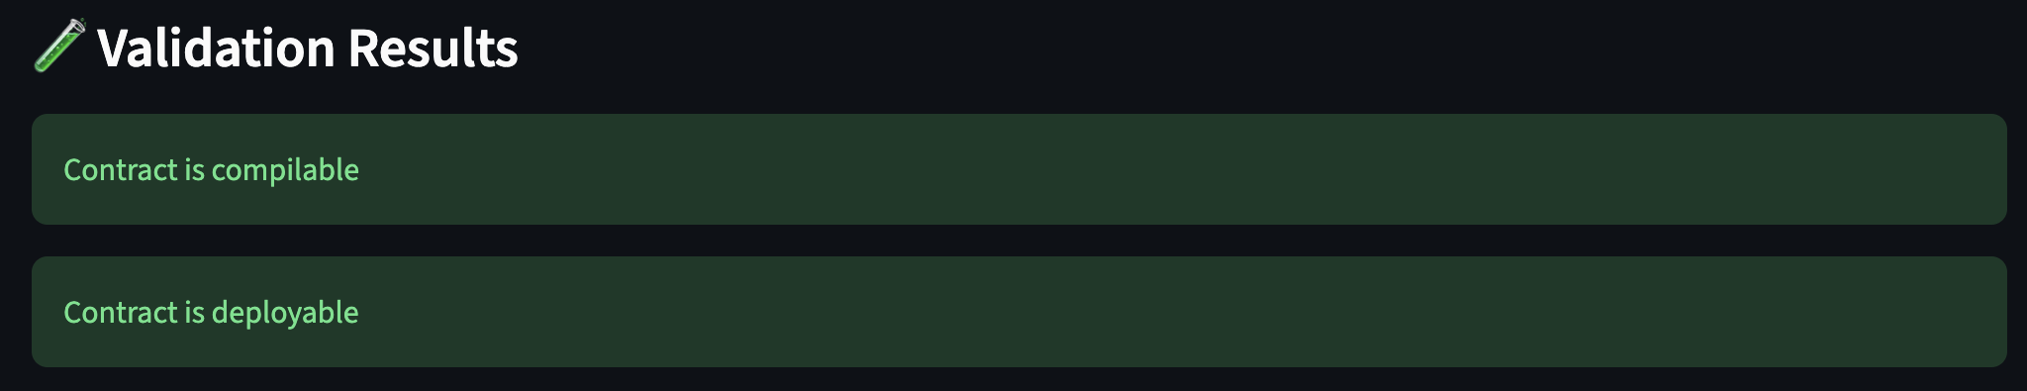

Slide 12
FineTune Dataset: Requirement → FSM → Code
Agentic AI, Fintech, & Data Economy
December 1, 2025
This smart contract is a [Zap-in transaction contract] for liquidity provision on Curve Finance. The main functions include [approving tokens, processing zap-in transactions with ETH or ERC20 tokens, and entering liquidity into Curve pools]. The contract transitions between states based on user interactions: [First, users call the ZapIn function to initiate a transaction with specified tokens, which checks and performs trades before adding liquidity to the selected Curve pool. The contract then returns the received pool tokens]. The main variables include [goodwill, stopped, exchange2Token, and various token addresses]. The main functions include [approveToken, ZapIn, ZapInWithETH, ZapInWithERC20, and liquidity entry functions]. The main events include [contract activation or pausing and token approval confirmations]. | { "contractName": "ZapInContract", "inherited contracts": [], "initialState": "Idle", "states": [ { "name": "Idle", "transitions": [ { "trigger": "ZapIn", "target": "Processing", "action": "initializeZapIn", "condition": "isActive" } ] }, { "name": "Processing", "transitions": [ { "trigger": "TokenApproved", "target": "LiquidityAdded", "action": "processTrade", "condition": "sufficientTokens" }, { "trigger": "Error", "target": "Failed", "action": "handleError" } ] }, | pragma solidity ^0.5.17; contract ZapInContract { uint public goodwill; bool public stopped; address public exchange2Token; mapping(address => bool) public tokenAddresses; enum State { Idle, Processing, LiquidityAdded, Failed } State public currentState; event ContractActivated(); event ContractPaused(); event TokenApprovalConfirmed(); constructor() public { goodwill = 0; stopped = false; exchange2Token = address(0); currentState = State.Idle; } modifier onlyActive() { require(!stopped, "Contract is paused"); _; } function approveToken(address token) public onlyActive { tokenAddresses[token] = true; emit TokenApprovalConfirmed(); }

Slide 13
Key Takeaways
Company Name
Date
1
2
3
4
NL to Solidity
Agentic Auto-Fixing
Structured + Verifiable
Learning + Prototyping
Users don’t need to know Solidity to get a validated smart contract
Contracts are generated, checked, and auto-fixed using real compile/deploy feedback
Pydantic schemas + MCP tools make the process transparent, repeatable, and auditable
Students, developers, and auditors can quickly explore, debug, and iterate on contract designs

Slide 14

Ask us anything!

Slide 15

Resources
Thank you!

